Slide 1
Cryptographic Hash Functions

Slide 2

Motivation: Integrity
VIRUS
badFile
goodFile
hash(goodFile)
User
Company
Software manufacturer wants to ensure that the executable file
is received by users without modification.
It sends out the file to users and publishes its hash somewhere
The goal is integrity, not secrecy
Given goodFile and hash(goodFile),
very hard to find badFile such that hash(goodFile)=hash(badFile)

Slide 3
Integrity vs. Secrecy
Integrity: attacker cannot tamper with message
Encryption does not guarantee integrity
  Intuition: attacker may able to modify message under encryption without learning what it is
    One-time pad: given key K, encrypt M as M⊕K
    This guarantees perfect secrecy, but attacker can easily change unknown M under encryption to M⊕M’ for any M’
    Online auction: change competitor’s bid without learning its value
  This is recognized by industry standards
    “RSA encryption is intended primarily to provide confidentiality… It is not intended to provide integrity” (from RSA Labs Bulletin)
  Some encryption schemes provide secrecy AND integrity

Slide 4
Authentication
KEY
KEY
msg, hash(KEY,msg)
Alice
Bob
Alice wants to make sure that nobody modifies message in transit
Ensures both integrity and authentication
Given msg, very hard to compute hash(KEY,msg) without KEY;
very easy with KEY

Slide 5
Hash Functions
hash function H
.
message
message
“digest”
x
.
.
y
.
x’’
.
y’
x’
bit strings of any length
n-bit bit strings
H is a lossy compression function
  Collisions: h(x)=h(x’) for some inputs x, x’
  Result of hashing should “look random” (make this precise later)
    Intuition: half of digest bits are “1”; any bit in digest is “1” half the time

Slide 6
One-Way
Hash should be hard to invert
  Preimage resistance: given random y∈{0,1}^{n}, hard to find any x such that h(x)=y
How hard?
  Brute-force: try every possible x, see if h(x)=y
  SHA-1 (common hash function) has 160-bit output
    Suppose have hardware that’ll do 2³⁰ trials a pop
    Assuming 2³⁴ trials per second, can do 2⁸⁹ trials per year
    Will take 2⁷¹ years to invert SHA-1 on a random image

Slide 7
Collision Resistance
Should be hard to find x, x’ such that h(x)=h(x’)
  Brute-force collision search is only O(2^{n/2}), not 2^{n}
Birthday paradox
  Consider t values x_{i} and corresponding y_{i}=h(x_{i})
  For each pair x_{i},x_{j}, there is 1/2^{n} probability of collision
  There is a total of choose(2,t)=t(t-1)/2 ∼ O(t²) pairs
  If t is close to 2^{n/2}, then number of pairs is close to 2^{n}, for each pair probability of collision is 1/2^{n}, thus probability of collision for some pair is close to 1

Slide 8
One-Way vs. Collision Resistance
One-wayness does not imply collision resistance
  Suppose g is one-way
  Define h(x) as g(x’) where x’ is x except the last bit
    E. g. h(1000101010)=g(100010101)
    E. g. h(1000101011)=g(100010101)
  h is one-way (to invert h, must invert g)
    Find y such that h(y)=z
    Find y’ such that g(y’)=z where y’=y – last bit
  Collisions for h are easy to find: for any x
    h(x0)=h(x1)

Slide 9
One-Way vs. Collision Resistance
Collision resistance does not imply one-wayness
  Suppose g is collision-resistant
    hard to find y, y’ such that g(y)=g(y’)
  Define h(x) to be 0x if x is n-bit long, 1g(x) otherwise
  Collisions for h are hard to find:
    if y starts with 0, then there are no collisions
    if y starts with 1, then must find collisions in g
  h is not one way:
    half of all y’s (those whose first bit is 0) are easy to invert
    random y is invertible with probability 1/2

Slide 10
Weak Collision Resistance
Given randomly chosen x, hard to find x’ such that h(x)=h(x’)
  Attacker must find collision for a specific x. By contrast, to break collision resistance, enough to find any collision.
  Brute-force attack requires O(2^{n}) time

Slide 11
Which Property Do We Need?
UNIX passwords stored as hash(password)
  One-wayness: hard to recover password
  Weak collision resistance: hard to find another password that’ll hash to the same value
Integrity of software distribution
  Weak collision resistance
Auction bidding
  Alice wants to bid B, sends H(B), later reveals B
  One-wayness: rival bidders should not recover B
  Collision resistance: Alice should not be able to change her mind to bid B’ such that H(B)=H(B’)

Slide 12
Common Hash Functions
MD5
  128-bit output
  Designed by Ron Rivest, used very widely
  Collision-resistance broken (summer of 2004)
RIPEMD-160
  160-bit variant of MD-5
SHA-1 (Secure Hash Algorithm)
  160-bit output
  US government (NIST) standard as of 1993-95
    Also the hash algorithm for Digital Signature Standard (DSS)

Slide 13
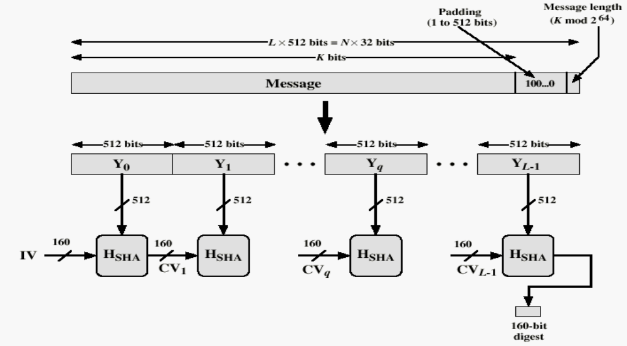
Basic Structure of SHA-1
Against padding attacks
Split message into 512-bit blocks
160-bit buffer (5 registers)
initialized with magic values
Compression function
Applied to each 512-bit block
and current 160-bit buffer
This is the heart of SHA-1

Slide 14
Reminder: Block Ciphers
Block of plaintext
Key
S
S
S
S
For hashing, there is no KEY.
Use message as key and replace
plaintext with a fixed string.
S
S
S
S
repeat for several rounds
S
S
S
S
Block of ciphertext

Slide 15
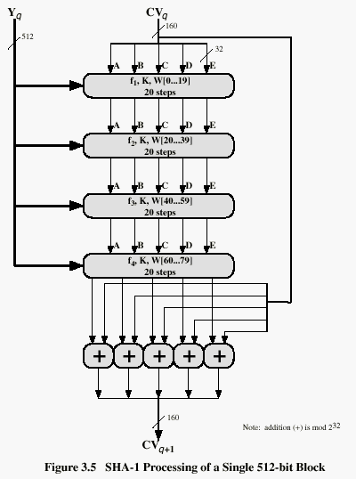
SHA-1 Compression Function
Current buffer (five 32-bit registers A,B,C,D,E)
Current message block
Four rounds, 20 steps in each
Let’s look at each step
in more detail…
Very similar to a block cipher,
with message itself used
as the key for each round
Fifth round adds the original
buffer to the result of 4 rounds
Buffer contains final hash value

Slide 16
One Step of SHA-1 (80 steps total)
A
B
C
D
E
+
Logic function for steps
(B∧C)∨(¬B∧D) 0..19
B⊕C⊕D 20..39
(B∧C)∨(B∧D)∨(C∧D) 40..59
B⊕C⊕D 60..79
f_{t}
+
5 bitwise
left-rotate
Current message block mixed in
For steps 0..15, W_{0..15}=message block
For steps 16..79,
W_{t}=W_{t-16}⊕W_{t-14}⊕W_{t-8}⊕W_{t-3}
W_{t}
+
Multi-level shifting of message blocks
30 bitwise
left-rotate
Special constant added
(same value in each 20-step round,
4 different constants altogether)
K_{t}
+
A
B
C
D
E

Slide 17
How Strong Is SHA-1?
Every bit of output depends on every bit of input
  Very important property for collision-resistance
Brute-force inversion requires 2¹⁶⁰ ops, birthday attack on collision resistance requires 2⁸⁰ ops
Some very recent weaknesses (2005)
  Collisions can be found in 2⁶³ ops

Slide 18
Authentication Without Encryption
KEY
MAC
(message authentication code)
KEY
message, MAC(KEY,message)
?
Alice
message
=
Bob
Recomputes MAC and verifies whether it is
equal to the MAC attached to the message
Integrity and authentication: only someone who knows KEY can
compute MAC for a given message

Slide 19
HMAC
Construct MAC by applying a cryptographic hash function to message and key
  Could also use encryption instead of hashing.
  Hashing is faster than encryption in software
  Library code for hash functions widely available
  Can easily replace one hash function with another
  There used to be US export restrictions on encryption
Invented by Bellare, Canetti, and Krawczyk (1996)
  HMAC strength established by cryptographic analysis
Mandatory for IP security, also used in SSL/TLS

Slide 20
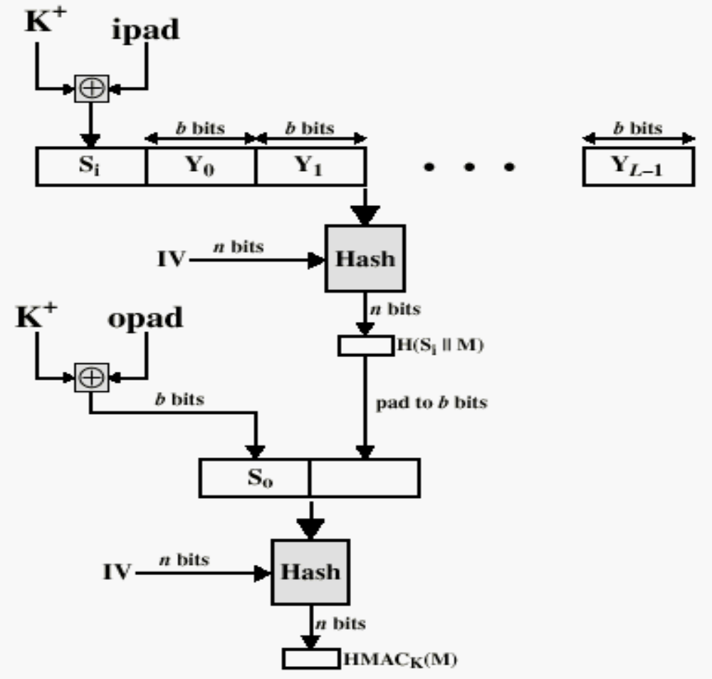
Structure of HMAC
magic value (flips half of key bits)
Secret key padded
to block size
Block size of embedded hash function
another magic value
(flips different key bits)
Embedded hash function
(strength of HMAC relies on
strength of this hash function)
“Black box”: can use this HMAC
construction with any hash function
(why is this important?)
“Amplify” key material
(get two keys out of one)
Very common problem:
given a small secret, how to
derive a lot of new keys?
hash(key,hash(key,message))

Slide 21


Applications of Cryptographic Hash Functions
1
2
3
4
Sign each packet (RSA, DSA,…)
Properties
  Immediate authentication
  Robust: packets individually verifiable
  Computational load too high
Notes:
Therefore need to amortize each signature over several packets.

Slide 22
Amortization: hash function
1
2
Hash(2)
Digital signature
Collision-resistant hash function h:
Given h(x), hard to find y such that h(x)=h(y)
Hash 100 times faster than digital signature

Slide 23
Hash chain
Sender processes the stream backwards
  Append the hash of P_{i+1} to P_{i}
  Sign only the first packet
Properties
  Immediate authentication
  Extremely efficient:
    1 hash computation / packet
    Overhead: 20 bytes / packet
  Vulnerable to packet loss
  Offline stream only
1
2
3
4
…
h(2)
h(3)
h(4)
Notes:
The two problems will be addressed one by one
Our contribution: study the problem of packet loss

Slide 24
Merkle Tree
Sign
Sender:
Packet 3 is sent as:
Robust against worst-case packet-loss
Trade-off
  More packets per group: buffering, communication overhead
  Fewer packets per group: computational overhead
hash
h(1)
1
2
3
4
5
6
3
1
2
4
5
6
Notes:
Go back to hash chain: was efficient and on the fly verification
But problem were that offline only and vulnerable to packet loss
Explain how verification works

Slide 25
Merkle Tree
Sign
1
2
3
4
5
6
7
8
Packet 3 is sent as:
Properties
  Robust against worst-case packet loss
  Traded a few more hash computations for lower communication overhead
3

